Slide 1
Logical database design 1
Normalisation

Slide 2
Learning outcomes
Learning outcomes – the student will be able to
Provide examples of DB design issues – redundancy & insert/update/modification anomalies
Describe the basic theory of Functional Dependency (FD)
Define the normal forms – 1NF, 2NF, 3NF
Be able to apply the process of normalisation using the ‘table splitting’ technique

Slide 3
Database Design
The DB design problem:
Given a body of data to be represented in a database – how do we decide a suitable logical structure for that data?
What relations should exist and what attributes should they include?
This is a LOGICAL design question – not PHYSICAL

Slide 4
Logical Database Design Process
The database design process follows these steps:
Analysis:
Enterprise Rules: The first step is an analysis of the enterprise to formulate ‘enterprise rules’.
Data: Next analyse the enterprise to discover the relevant data that is required by the business.
Entity/Relationship Modelling
Entities: These rules are then used to identify possible groupings of data attributes into proposed tables (entities).
Relationships: Relationships between entities/tables are identified and proposed table designs produced (E/R Model Diagrams)
Normalisation of Tables
Functional Dependencies: The possible/proposed tables are then analysed to identify functional dependencies between attributes in the table.
Normalisation: Once the functional dependencies are defined in each table- the process of normalisation takes place. This involves ‘table splitting’ – a diagrammatic technique. (based on Functional Dependency Diagrams)

Slide 5
Logical Database Design Process
The database design process follows these steps:
Analysis: (next lecture)
Enterprise Rules: The first step is an analysis of the enterprise to formulate ‘enterprise rules’.
Data: Next analyse the enterprise to discover the relevant data that is required by the business.
Entity/Relationship Modelling (next lecture)
Entities: These rules are then used to identify possible groupings of data attributes into proposed tables (entities).
Relationships: Relationships between entities/tables are identified and proposed table designs produced (E/R Model Diagrams)
Normalisation of Tables (this lecture)
Functional Dependencies: The possible/proposed tables are then analysed to identify functional dependencies between attributes in the table.
Normalisation: Once the functional dependencies are defined in each table- the process of normalisation takes place. This involves ‘table splitting’ – a diagrammatic technique. (based on Functional Dependency Diagrams)

Slide 6
Why Normalise Tables?
Elimination of Redundancy
Redundancy issues:
Redundancy is unnecessary duplication
Redundancy wastes storage space
Is a risk to integrity of data –
modification anomaly.
insertion anomaly
deletion anomaly

Slide 7
Course_Result (non normalised)
All columns contain DUPLICATE values – can any be deleted without loss of information? (Note PK = Student_Nr & Course_Nr)

Slide 8
Non Redundant Data
Deleting the GRADE as shown – we will no longer be able to determine the students grade for that subject. Therefore data in the GRADE column is not REDUNDANT

Slide 9
Non Redundant Data
Deleting the Course_Nr as shown – we will no longer be able to determine the students subject for that grade. Therefore data in the COURSE_NR column is not REDUNDANT

Slide 10
Redundant Data
Deleting the ‘Programming2’ subject however does not lead to the same problem. We can deduce from the Course_Nr (2BA2) what the course title is. So the data in the Course_Title column is REDUNDANT – unnecessary duplication.

Slide 11
Deletion Anomaly
Student number ‘123’ leaves the college and the corresponding data is deleted. The associated data for Course ‘1BA6’ is also deleted and therefore lost – this is called the DELETION anomaly.

Slide 12
Insertion Anomaly
A new course ‘3BA1’ is required to be added – but no students are registered. Since Student_Nr is the PK it may not be left empty (NULL) so the DBMS prevents the addition of the new tuple – this is called the INSERTION anomaly.

Slide 13
Modification Anomaly
The course title in the 4th tuple is changed. It is now inconsistent with the other course title with the same course number. Which one is correct? This is called the modification anomaly.

Slide 14
Normalisation
The process of creating a good logical table design is a process referred to as normalisation.
Results in Elimination of Redundancy
Redundancy issues:
Redundancy is unnecessary duplication
Redundancy wastes storage space
Is a risk to integrity of data –
Normalisation is implemented by application of normalisation rules – The ‘Normal Forms’
Normalisation may be accomplished using a diagrammatic technique called Functional Dependency

Slide 15
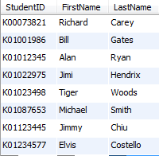
Functional dependency
Functional dependency is a way of describing relationships between attributes in a table.
In the students table – we can say that the StudentID attribute determines the FirstName and LastName attributes.
In other words FirstName and LastName are functionally dependant on StudentID – the Primary Key
This can be expressed Diagrammatically to aid analysis of the table structure.
We’ll see in a minute how we can use diagrams like this to analyse a table structure and apply the rules for normalisation
students table
LastName
StudentID
PK
FirstName

Slide 16
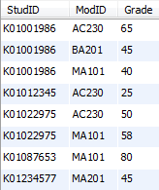
FD and Composite PKs
A composite PK can be illustrate by grouping attributes inside a bounding box
StudID
Grade
ModuleID
PK
results table

Slide 17
Normal Forms
These are a set of rules that, if applied to a table design, can be said to lead to a good logical table design.
Normal form rules build on each other – leading to ever more refined table designs.
We are going to concern ourselves with the fist 3 rules.

Slide 18
1st Normal form
One attribute, two values
Rule: the domain of each attribute may contain only a single (atomic,indivisible) value.
This is pretty intuitive as you can see from the students table.
There would be no sense adding extra data to the 3rd column such as Date of Birth.
,DOB
15/01/89
12/11/63
25/7/77
21/3/99
11/1/98
25/4/78
16/5/98
16/5/98
students table
1NF NO
LastName, DOB
StudentID
PK
FirstName
1NF YES

Slide 19
1st Normal form
The problem is resolved by splitting the offending column to create two columns.
Here – DOB becomes an attribute which is dependant on StudentID
,DOB
15/01/89
12/11/63
25/7/77
21/3/99
11/1/98
25/4/78
16/5/98
16/5/98
students table
DOB
1NF YES
LastName
StudentID
1NF YES
PK
FirstName
1NF YES

Slide 20
2nd Normal form rule
First, the table must be in 1st Normal Form
Next , all NON KEY attributes must depend on the Primary Key.
This is true for both of these tables:
DOB
2NF YES
FK
2NF YES
StudID
2NF YES
Grade
LastName
ModID
StudentID
PK
FirstName
PK
results
students
2NF YES

Slide 21
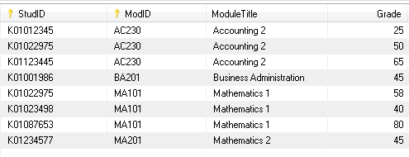
What if..
We had module titles in the results table:
Notice how the ModuleTitle Attribute is dependant on only PART of the PK
This can be resolved by splitting the table.
PK
2NF YES
StudID
Grade
ModID
2NF NO
results
ModuleTitle

Slide 22
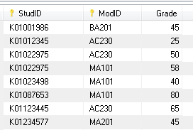
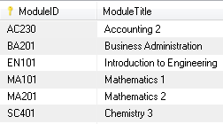
Table splitting
Table splitting produces two tables with a FOREIGN KEY relationship.
PK
StudID
Grade
results
ModID
2NF YES
FK
ModID
PK
modules
2NF YES
ModuleTitle

Slide 23
3rd Normal Form
To be in 3rd normal form – a table must first conform to 1st and 2nd normal Form
Then all non-key attributes must depend solely on the PK – ie no transitive dependancies.

Slide 24
Transitive Dependency
IF there are 3 attributes in a table where
A→ B
B→ C
Then we can say A→ C
This is referred to as Transitive Dependency
PK
3NF YES
3NF NO
A
B
C

Slide 25
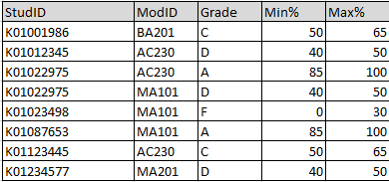
Transitive dependency example
Lets say in our results table we used a letter grade to indicate a range of percent values – for example ‘A’ = 85%-100%
PK
3NF YES
StudID
Grade
ModID
results
In this example – the Max% and Min% attributes are transitively dependant on the PK, Again the problem is resolved by table splitting
Max%
Min%
3NF NO
3NF NO

Slide 26
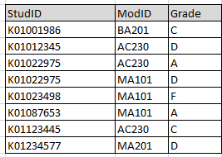
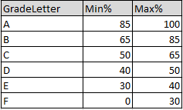
After table splitting..
Again we get two tables with a FK relationship
Result
GradeLookup
GradeLetter
PK
PK
3NF YES
StudID
Grade
ModID
FK
Max%
Min%
3NF YES
3NF YES

Slide 27
Summary
B
1NF
2NF
3NF
A
B,C
A
C
A
C
A
C
B
B
B
D
D
A
B
C
A
B
B
C

